Slide 1


Karen Henderson
Exceptional Student Service Director
Window Rock Unified School District
July 25, 2024
Notes:
We designed this template so that each member of the project team has a set of slides with its own theme. Members, here’s how you add a new slide to just your set:
Mark where you want to add the slide: Select an existing one in the Thumbnails pane, click the New Slide button, then choose a layout. The new slide gets the same theme as the other slides in your set.
Careful! Don’t annoy your fellow presenters by accidentally changing their themes. That can happen if you choose a different theme from the Design tab, which changes all of the slides in the presentation to that look.

Slide 2

What is Child Find?
The intent of Child Find is that all children birth through age 21 with delays or disabilities are
LOCATED
IDENTIFIED
EVALUATED
to receive the supports and services they need.

Slide 3

Child Find
All Public Education Agencies (PEA) in the state and the Arizona Early Intervention Program (AzEIP) are required to locate, identify, and evaluate children with disabilities who are located within their geographical boundaries, including children who are homeless, ward of the state, placed in private school.

Slide 4

Child Find Components
Annual review of procedures with school staff
Disseminate procedures to parents
Public awareness
Annual determination for private and home-schooled students
Referral
Screening
Tracking
Evaluation

Slide 5

Child Find Public Awareness
Advertise availability of special education services for preschool and school-aged children
Advertise availability of early intervention services for children birth to 3 years old through AzEIP
Annually provide parents and school-based staff with written Child Find Procedures
Annual consult with private school representatives and parents of parentally-placed private school children with disabilities

Slide 6




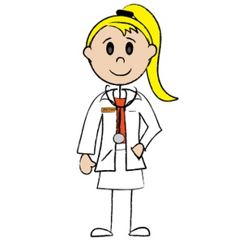
Child Find Referral Process
A child can be referred by
Parent/Caregiver/Relatives
Preschool/Daycare Centers/Head Start Centers
School Staff
Doctors/Health Providers
Anyone interested in the child’s developmental/educational needs

Slide 7

Child Find Referral Process
Referrals vary by age of child:
Birth to 3 to AzEIP
3 to 5 District Office
K-21 Building Principal or Administrator

Slide 8

What to look for in Birth to 5
Communication
Cognitive
Social
Adaptive
Physical
Vision/Hearing

Slide 9


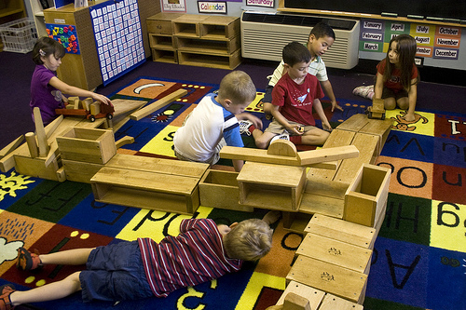
Child Find Birth to Five
Referred to a specialist to screen their development
Evaluated further if preliminary screening identifies an area(s) of concern
Determined eligible – or ineligible – to receive services based on state definitions of delay or disability and need for services.

Slide 10

What to look for in Kindergarten to age 21
Vision/Hearing
Motor Control or Coordination
Behavior or Social Skills
Speech or Language Skills
Thinking or Performing Skills

Slide 11
What to look for in Kindergarten to age 21
New enrollment require 45 day student screening report
Administrative Action
  Current Individual Education Plan (IEP)
  Refer to RTI (Response to Intervention) Team
  Refer for 504 Plan
  No action needed if student passes

Slide 12

Our Responsibility
All staff are required to:
  Cooperate in completing 45 day screenings as designated by building administration
  Report concerns to the Child Find Coordinator for children birth through 5
  Report concern to building site RTI team members for children K-21
  Refer concerned parents to Child Find dates and/or Child Find/RTI team members.

Slide 13


